Slide 1

STAC-A3 Background and Portfolio Trading Benchmark Proposal v0.3
April 18, 2023
Bishop Brock
Head of Research, STAC
bishop.brock@STACresearch.com
Peter Nabicht
President, STAC
peter.nabicht@STACresearch.com
CONFIDENTIAL: This document is for the exclusive internal use of members of the STAC Benchmark Council and is
governed by the STAC Benchmark Council membership agreement. Do not distribute outside your firm.

Slide 2
STAC-A3 Recap – Data Model
HAAA
A STAC-provided message generator creates synthetic messages for high (H) and low (L) volume instruments as a preprocessing step.
At run time, the SUT processes the order files to create and trade from limit order books
STAC-ProvidedMessage Generator
. . .
LZZZ
Preprocessing
Run-Time

Slide 3
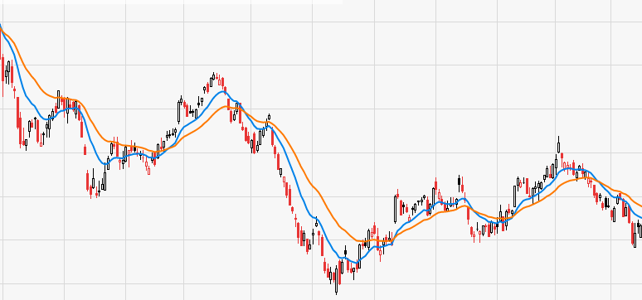
STAC-A3 Recap – Mean Revert (Current Benchmark)
A simple strategy that trades EMA crossovers based on 1-second bars
Scalability variables
  The number of symbols traded
  The number of EMA parameter sets simulated
  The length (in simulated days) of the simulation
Very simple
  Strategy only looks at midpoint and best bid/offer
  EMA is probably the simplest technical indicator to compute
Embarrassingly parallel
  Symbols, parameter sets, and even days can be simulated in parallel
  But: Must amortize the 1-time cost of message processing over many experiments

Slide 4
STAC-A3 Recap: BLASH (Proposal)
BLASH (Buy-Low/Sell-High) is an incomplete, never-implemented spec.
BLASH was designed to extend the computational complexity of STAC-A3 by addressing a couple of aspects of Mean-Revert:
Mean-Revert is embarrassingly parallel by parameter set and symbol
  In BLASH, instruments traded today depend on global technical analysis on the entire universe of symbols (daily high/low + volume between extremes)
  This analysis will almost certainly be done in parallel as a preprocessing step
Mean-Revert only looks at the top-of-book on either side
  BLASH specifies a strategy requiring analysis of the full ask-side book at certain points
However, analysis showed that BLASH implementations:
  Would still admit very high or unrealistic parallelism
  Could use “tricks” to short-circuit backtesting, and almost eliminate the order-book analysis

Slide 5
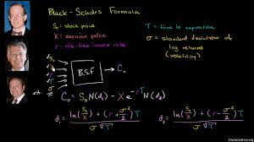
STAC-A3 Recap: Options (Preliminary Proposal)
Work underway at the end of 2022 to define a backtest that included options
In short, the idea was to run Mean-Revert but trade options instead of the underlying, plus calculate Greeks at the signal points

Slide 6
How does Portfolio Trading Benchmark (PTB) proposal address previous issues?
Reducing embarrassing parallelism:
Path-dependent strategy
  Portfolio weights assigned (daily or intraday) by optimization algorithm
  # quantity traded per instrument depends on weights and portfolio value
    Portfolio value evolves from the beginning of time
  → Must interlock each day
Fine-Grained Interlock
  Multiple trades per instrument per day
  Quantity traded per instrument depend on weights and risk budget available at entry
  → Can not simulate instruments completely in parallel
    Risk budget at time T depends on results of all portfolio trades exiting before time T
NB: Parameter sets can still be simulated fully in parallel

Slide 7
How does the proposed PTB address these issues? (cont.)
Order book not really being used
Simulated trades are based on simulated market depth and volume
  Computing fill price requires analysis of a sorted book
Certain short-circuit “tricks” are precluded by:
Multiple trades per instrument per day is guaranteed
Trades have both stop and target levels
NB: This strategy, like BLASH, requires order book analysis only at certain times. We have not considered strategies that require order book analysis on every tick.

Slide 8
High Level View
Real-Time Market Data
PTB models a set of independent strategies S0, … Sn, each reacting to real-time market data, but coordinating trading activity through a real-time portfolio risk mechanism.
Coordination could be daily (easier) or intraday (harder).
S0
S1
. . .
Sn
Real-Time Portfolio Risk

Slide 9
Simulation-Level View
A signal point of a strategy
Up-to-date portfolio view may be required
Strategies (Instruments)
Trade decision and trade parameters based on global portfolio state at each signal point
Time →
Easier Model: Signal point actions can be computed independently
Harder Model: … cannot always be ...

Slide 10
Portfolio Trading Benchmark (PTB) Overview
Portfolio begins with large cash balance
A large universe of U instruments, High and Low volume
Each day, trade N out of U instruments selected by global technical analysis of the entire universe of symbols
Each trade takes a position based on current cash balance and optimized weights
Simple entry conditions; Complex exit conditions
Simulated fills based on the elaborated order book at that point
Portfolio is flat at end of day, final daily cash balance is reported, then simulate next day.

Slide 11
PTB Details
Instrument Selection
  I/O Intensive: Market data for every instrument will be read and processed for every day in the backtest
Portfolio optimization to determine security weights
  Adds a realistic numerical algorithm to the backtest
  Maximum Sharpe; Minimum Variance; Hierarchical Risk Parity; others?
  Run daily or run intraday?

Slide 12
PTB Details (cont.)
Simple entry conditions
  Artificial signals based on volume evolution allows the number of trades to be controlled by parameters
2 Options (Pun Intended?):
  Complex exit conditions
    Exit conditions designed to defeat pre-computation and “tricks”:
    “Triple-Barrier” exits with stop, target and timeout
    Stop/target based on size-weighted book (rather than midpoint) requires more complex book analysis than Mean-Revert
  Options?
    We could specify an options strategy, e.g., dynamic hedging/Gamma scalping

Slide 13
Backup / Details

Slide 14
Market Data Changes Required
The market data generator used for STAC-A3 must be modified such that events do not fall on a fixed time interval.
We may also allow slightly different numbers of events per symbol per day and may address the excessive/inconsistent volatility of the simulated instruments.
Note: We have studied the NVIDIA and Intel Mean-Revert codes, and we do not believe that these codes take advantage of, or depend on the events arriving at a fixed frequency
  I.e., those codes should still work with the proposed new data generator
    But they will need to be slightly modified anyway for minor changes to Mean-Revert specs.

Slide 15
Parameters Background
PTB specifies a sweep over 9 parameters
Like Mean-Revert, many parameters are given in seconds, however these putative “seconds” refer to volume accumulations at the average rate, which is a given and is constant for Low/High volume symbols
Stop/target parameters are given in basis points (%0.01)

Slide 16
Parameters Details
Parameter | Units | Notes | Sim. T?*
Signal | Sec. | An entry signal is generated every “Signal” seconds of equivalent volume. | Yes
Signal Delay | Sec. | Delay from open before daily signal gen. begins | No to slight
DP1, DP2 | Sec. | Parameters of a simple indicator used to determine whether to go long or short, e.g., VWAP over recent past | No
Stop, Target | Bps | Stop / Target offsets from fill price in basis points. Maybe better to specify these as fractions of current realized volatility? | Yes
Timeout | Sec. | Trade timeout if neither Stop nor Target is hit | Yes
Tv | Sec. | Time interval used to compute realized volatility for portfolio optimization | Slight to None
Lookback | Days? | How many days to look back for portfolio optimization | Yes
* Does this parameter affect simulation time? However, it all depends on how the vendor implements it in the end.

Slide 17
Characterization
Symbol LAAA, 20 days (includes 1 high-volume day)
952,514 events (orders)
  Only 47,625 per day on average
  2 per second
4,544,542 Bid Levels
4,579,562 Ask Levels
Most efficient representation of the book for this month is 10M * 16 bytes
  Assumes 8-byte price, 8-byte volume
  160 MB
  1 Year = 1.92 GB
  Symbols / TB = 520
Assuming 10 fixed levels, space doubles

Slide 18
Characterization
Symbol HAAA, 20 days (includes 1 high-volume day)
12,700,550 events (orders)
  Only 635,028 per day on average
  27 per second
60,820,147 Bid Levels
60,958,943 Ask Levels
Most efficient representation of the book for this month is 122M * 16 bytes
  Assumes 8-byte price, 8-byte volume
  1.95 GB
  1 Year = 23.4 GB
  Symbols / TB = 43
Assuming 10 fixed levels, space doubles

Slide 19
Characterization Notes
These “instruments” are way too volatile, 100% range over 1 month!
10-12 order-book levels is a good fixed amount
17% of low-volume instruments minutes have no trades!
The orders are time-aligned – need to fix this

